Slide 1
Applying AI with Python
Alex Conway
alex@numberboost.com

Slide 2
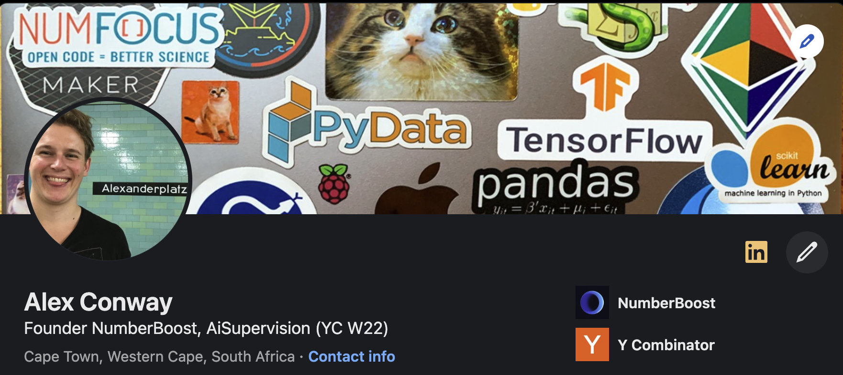
x.com/alxcnwy linkedin.com/in/alxcnwy/

Slide 3
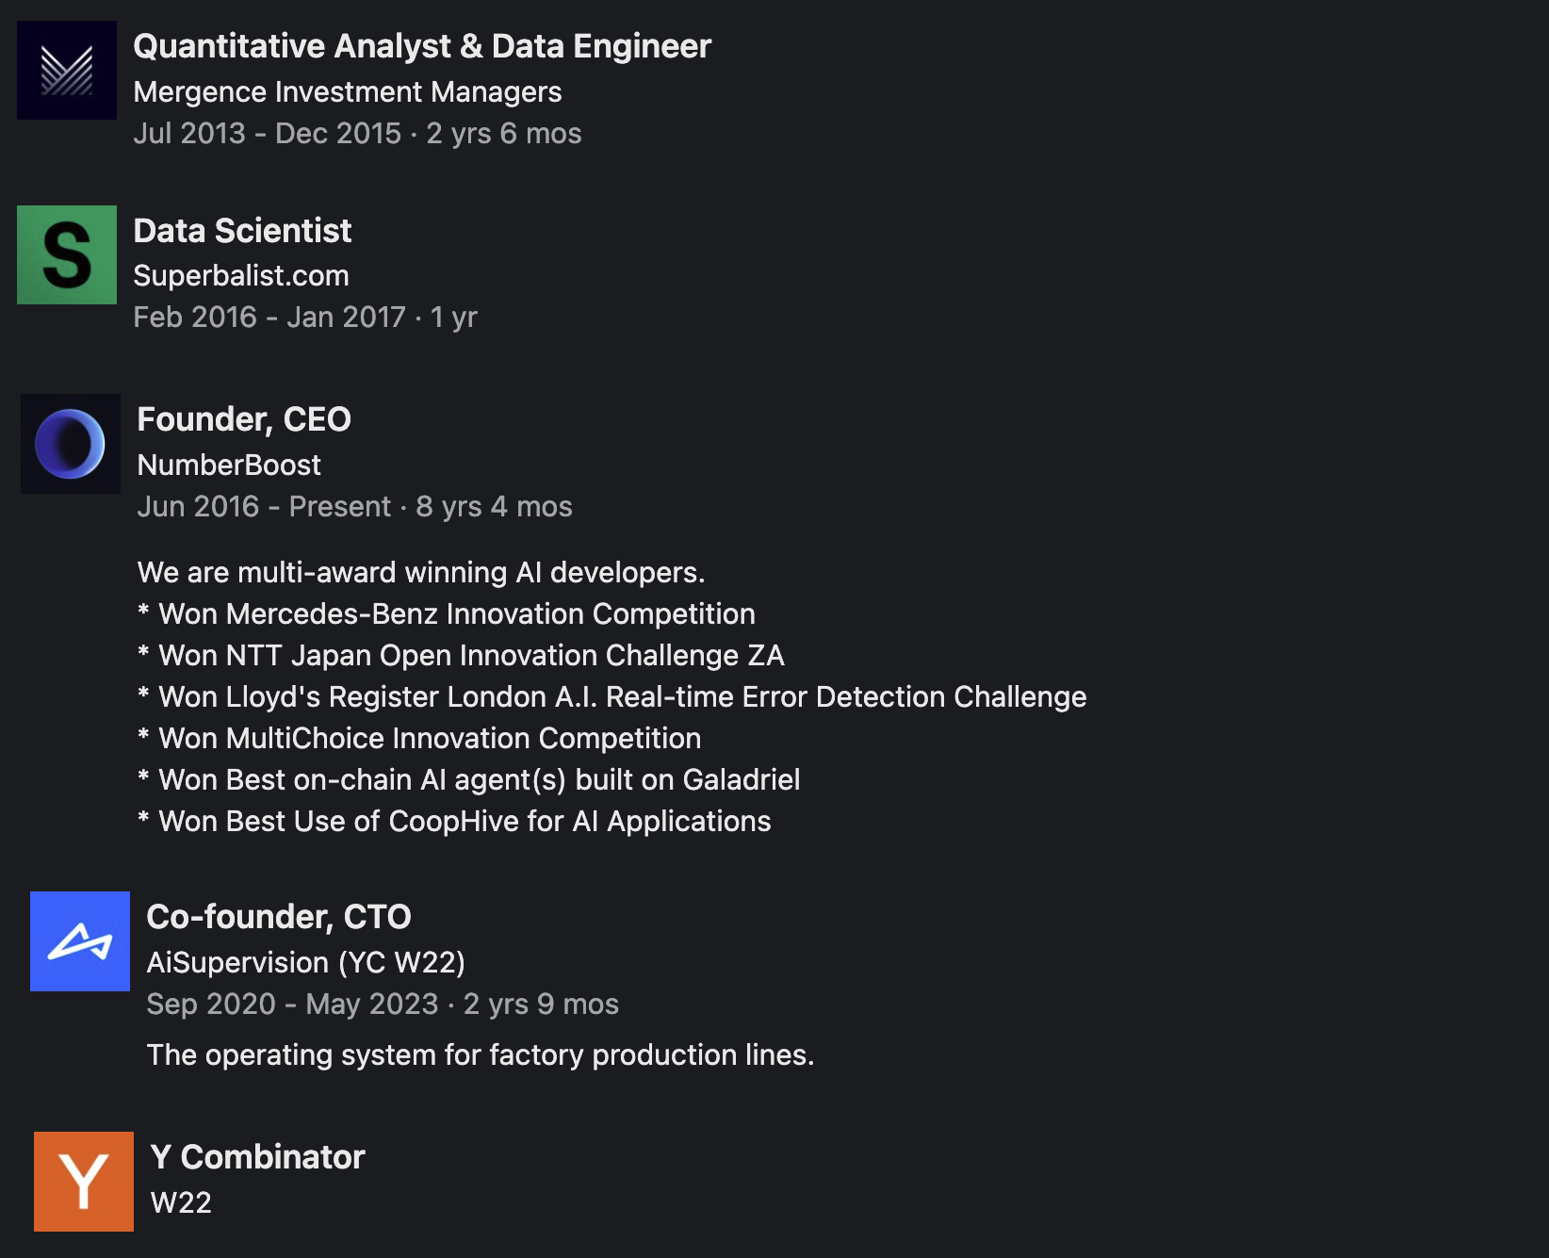

Slide 4
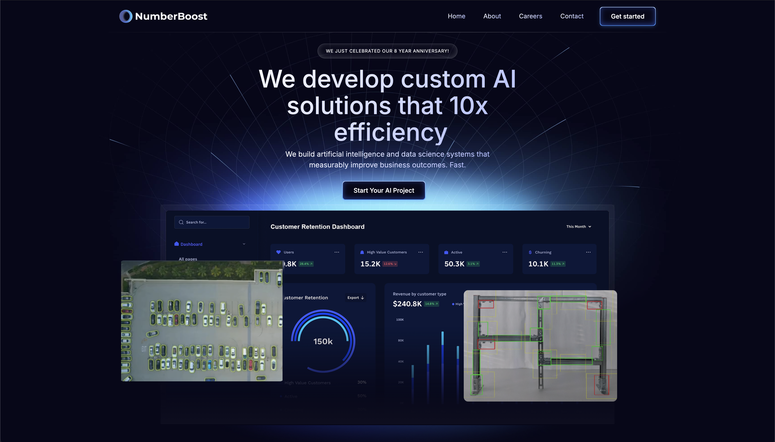

Slide 5

What is Artificial Intelligence (AI)?

Slide 6
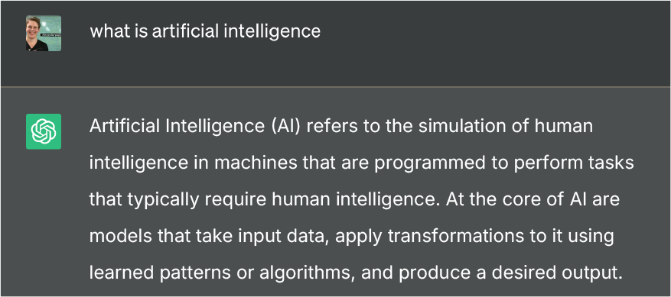

Slide 8

def ai_model(input):
#
# algorithms f(input) = output
#
return output

Slide 9
def ai_model(input):
#
# algorithms f(input) = output
#
return output

Slide 10
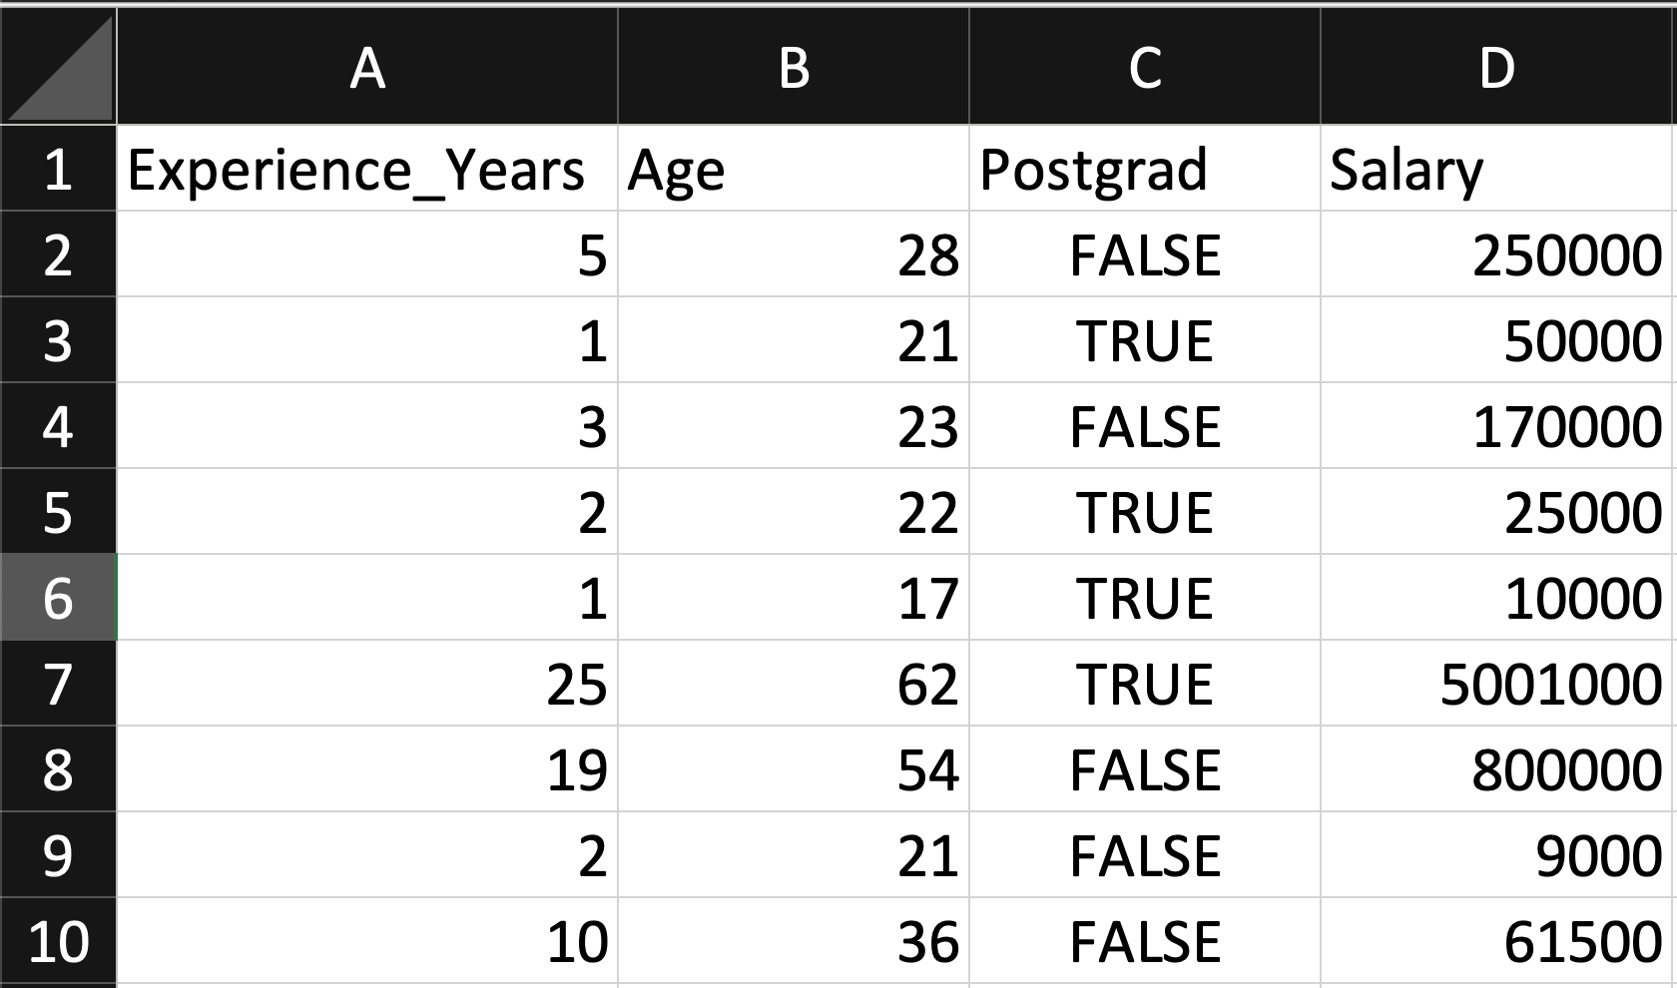
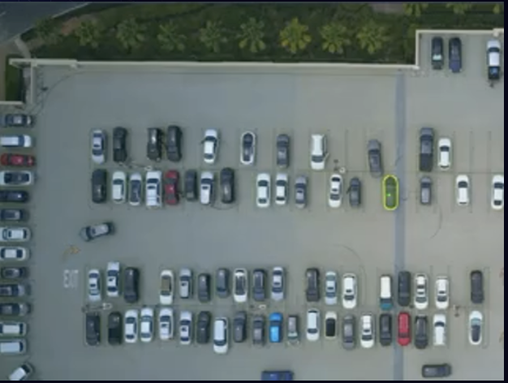
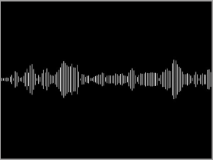
Input
Table
Image / Video
Artificial Intelligence (AI) is transforming industries and our lives by enabling computers to solve increasingly complex tasks, and Python stands at the forefront of this revolution. In this talk, we will explore how Python's rich ecosystem of AI libraries and frameworks can be harnessed to
Text
Audio

Slide 11
def ai_model(input):
#
# algorithms f(input) = output
#
return output

Slide 12
Algorithm Terminology
(Supervised) Regression (predict a number)
(Supervised) Classification (predict a category / label)
Unsupervised (find patterns within a dataset without labels)
Generative (create new data / content)

Slide 13
Types of AI Algorithms
Regression (Linear / Polynomial / Logistic, etc.)
Decision Trees (Random Forests, GBMs, etc.)
Clustering (K-Means, Spectral, DBSCAN, etc.)
Neural Networks (Convolutional, Recurrent, Transformer, etc.)
And more…

Slide 14
def ai_model(input):
#
# algorithms f(input) = output
#
return output

Slide 15
Output
Table
Image / Video
Artificial Intelligence (AI) is transforming industries and our lives by enabling computers to solve increasingly complex tasks, and Python stands at the forefront of this revolution. In this talk, we will explore how Python's rich ecosystem of AI libraries and frameworks can be harnessed to
Text
Audio

Slide 16
Output
Table
Image / Video
Artificial Intelligence (AI) is transforming industries and our lives by enabling computers to solve increasingly complex tasks, and Python stands at the forefront of this revolution. In this talk, we will explore how Python's rich ecosystem of AI libraries and frameworks can be harnessed to
Text
Audio

Slide 17
Output
Table
Image / Video
Artificial Intelligence (AI) is transforming industries and our lives by enabling computers to solve increasingly complex tasks, and Python stands at the forefront of this revolution. In this talk, we will explore how Python's rich ecosystem of AI libraries and frameworks can be harnessed to
Text
Audio

Slide 18
Output
Table
Image / Video
Artificial Intelligence (AI) is transforming industries and our lives by enabling computers to solve increasingly complex tasks, and Python stands at the forefront of this revolution. In this talk, we will explore how Python's rich ecosystem of AI libraries and frameworks can be harnessed to
Text
Audio

Slide 19
Output
Table
Image / Video
Artificial Intelligence (AI) is transforming industries and our lives by enabling computers to solve increasingly complex tasks, and Python stands at the forefront of this revolution. In this talk, we will explore how Python's rich ecosystem of AI libraries and frameworks can be harnessed to
Text
Audio

Slide 20
Output
Table
Image / Video
Artificial Intelligence (AI) is transforming industries and our lives by enabling computers to solve increasingly complex tasks, and Python stands at the forefront of this revolution. In this talk, we will explore how Python's rich ecosystem of AI libraries and frameworks can be harnessed to
Text
Audio

Slide 21
Output
Table
Image / Video
Artificial Intelligence (AI) is transforming industries and our lives by enabling computers to solve increasingly complex tasks, and Python stands at the forefront of this revolution. In this talk, we will explore how Python's rich ecosystem of AI libraries and frameworks can be harnessed to
Text
Audio

Slide 22
Output
Table
Image / Video
Artificial Intelligence (AI) is transforming industries and our lives by enabling computers to solve increasingly complex tasks, and Python stands at the forefront of this revolution. In this talk, we will explore how Python's rich ecosystem of AI libraries and frameworks can be harnessed to
Text
Audio

Slide 23
Output
Table
Image / Video
Artificial Intelligence (AI) is transforming industries and our lives by enabling computers to solve increasingly complex tasks, and Python stands at the forefront of this revolution. In this talk, we will explore how Python's rich ecosystem of AI libraries and frameworks can be harnessed to
Text
Audio

Slide 24
Output
Table
Image / Video
Artificial Intelligence (AI) is transforming industries and our lives by enabling computers to solve increasingly complex tasks, and Python stands at the forefront of this revolution. In this talk, we will explore how Python's rich ecosystem of AI libraries and frameworks can be harnessed to
Text
Audio

Slide 25




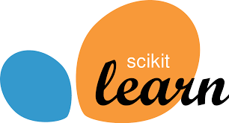



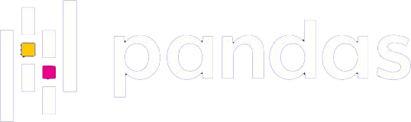
Why Python for AI?
Easy to use (ML researchers typically not software engineers)
Massive community (easy to find answers to questions)
Extensive libraries and frameworks (don’t need to invent to use)

Slide 26
Table Data

Slide 27
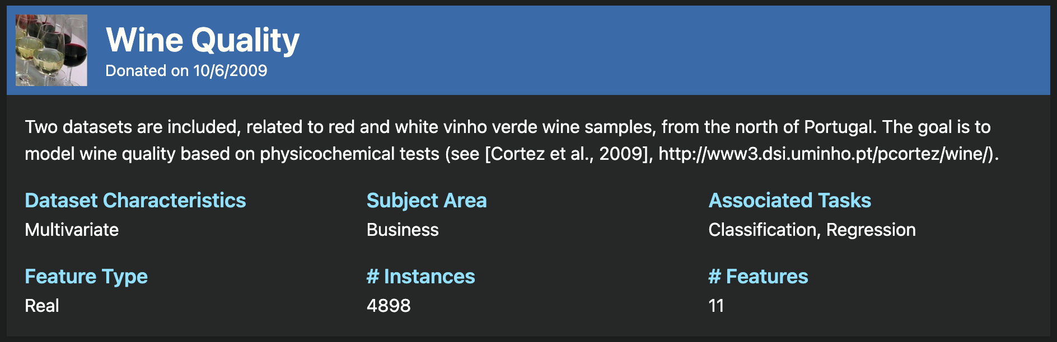
https://archive.ics.uci.edu/dataset/186/wine+quality

Slide 28
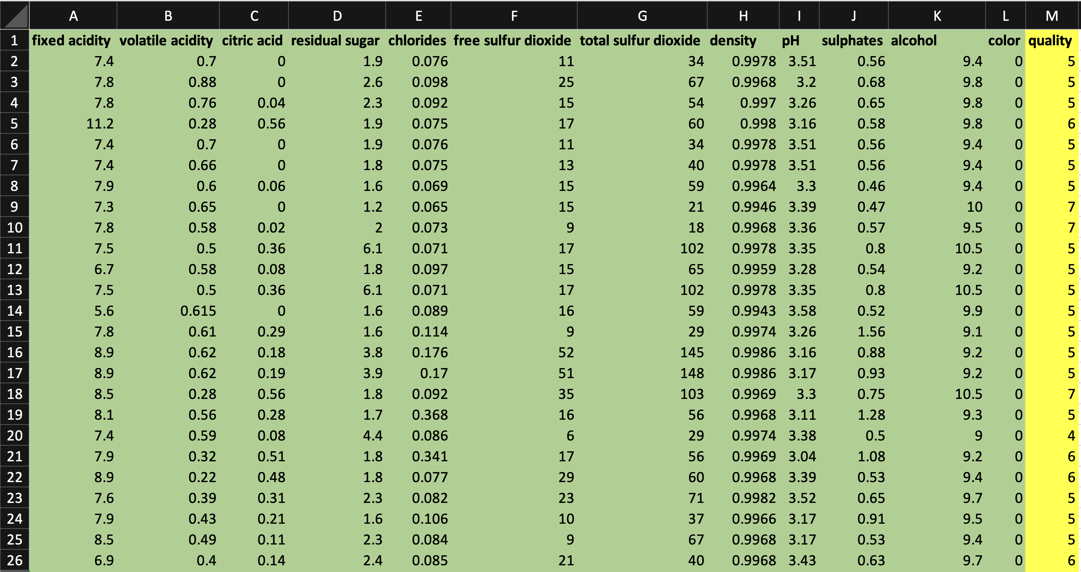
Regression Model
to Predict Wine Quality

Slide 29
Jupyter Notebook
TableData.ipynb

Slide 30
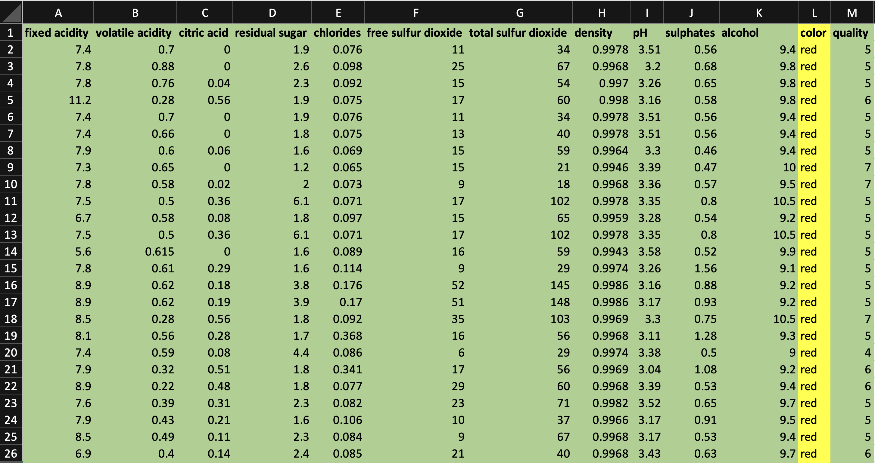
Classification Model
to Predict Wine Colour

Slide 31
Jupyter Notebook
TableData.ipynb

Slide 32
Image / Video Data

Slide 33
Computer Vision
Cool paragraph here
Second cool paragraph here
Etc

Slide 34

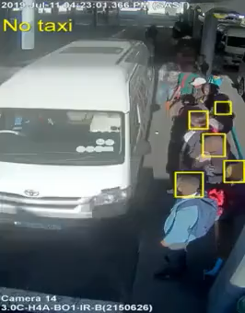

Slide 38
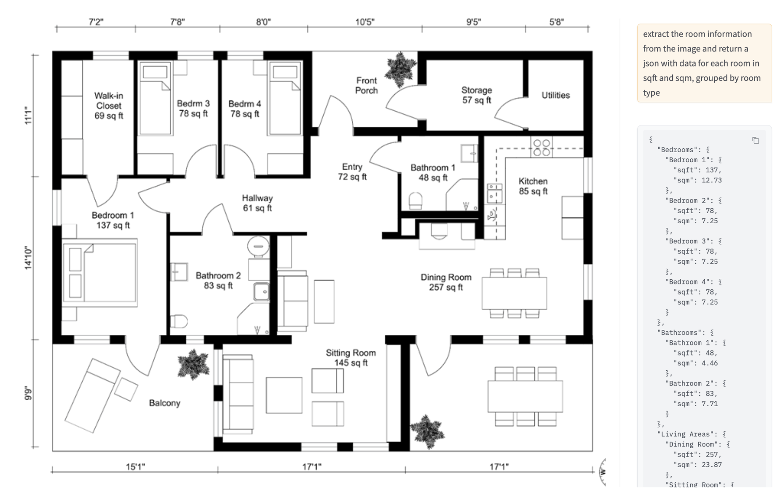

Slide 39
Speech Data

Slide 40
Speech Data
Todo
https://github.com/mbamvianney/SPEECH-EMOTION-RECOGNITION-WITH-MACHINE-LEARNING

Slide 45
Text Data

Slide 46
Text Data
Text classification
Entity extraction
RAG

Slide 51
AI Agents

Slide 52
AI Agents
RAG with SQL and function calling?

Slide 57
Conclusion

Slide 58
def ai_model(input):
#
# algorithms f(input) = output
#
return output

Slide 59
Chatgpt screenshot with terminology example

Slide 60
Thank You!
Alex Conway
alex@numberboost.com
x.com/alxcnwy

